Slide 1
Extracting information from text

Slide 2
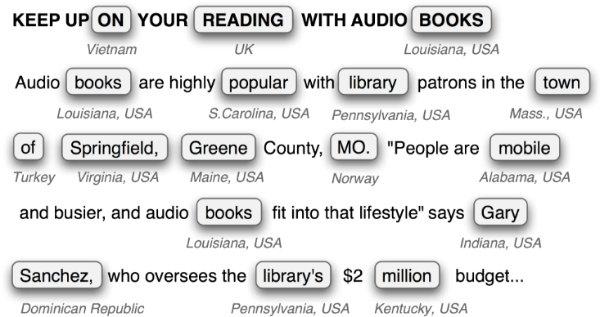
Useful information extracting

Slide 3
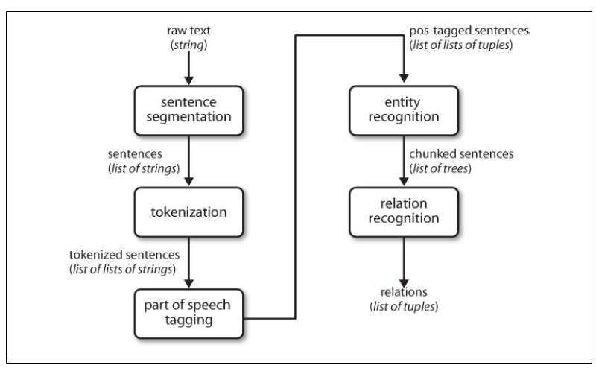
Architecture for information extraction

Slide 4
Tagging

Slide 5
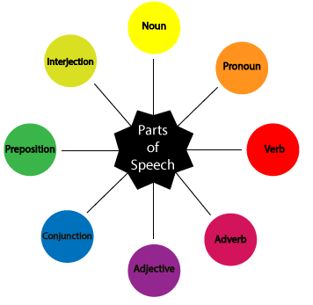
Part-of-speech (POS) tagging
•If you know a token's POS you know:
–is it the subject?
–is it the verb?
–is it introducing a grammatical
structure?
–is it a proper name?

Slide 6
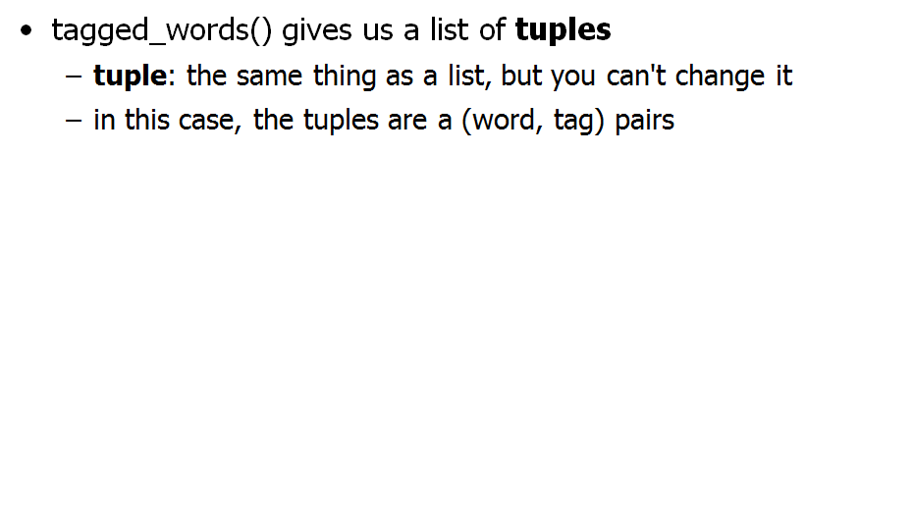
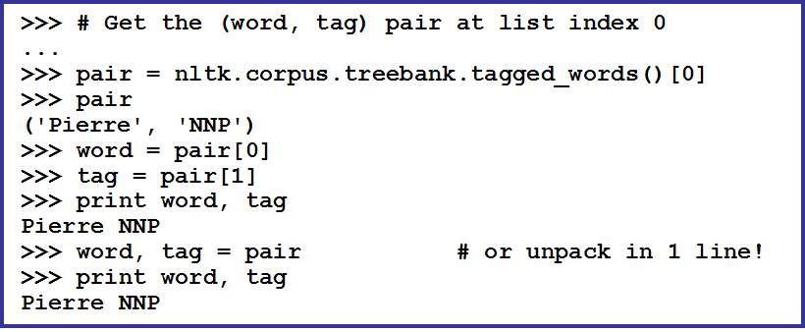
POS tagging

Slide 7
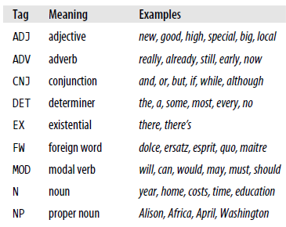
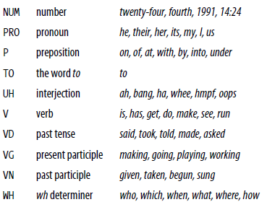
Examples

Slide 8
Basic NLTK tagginging
A very basic way to tag:
>>> import nltk
text = nltk.word_tokenize("They refuse to permit us to obtain the refuse permit")
>>> nltk.pos_tag(text)
[(’They’, ’PRP’), (’refuse’, ’VBP’), (’to’, ’TO’), (’permit’, ’VB’), (’us’, ’PRP’), (’to’, ’TO’), (’obtain’, ’VB’), (’the’, ’DT’), (’refuse’, ’NN’), (’permit’, ’NN’)]

Slide 9
Reading tagged corporag
NLTK has a variety of corpora to work with
(see http://nltk.org/book/ch02.html)
>>> nltk.corpus.brown.tagged_words()
[(’The’, ’AT’), (’Fulton’, ’NP-TL’), ...]
>>> nltk.corpus.brown.tagged_words(simplify_tags=True) [(’The’, ’DET’), (’Fulton’, ’NP’), (’County’, ’N’), ...]

Slide 10
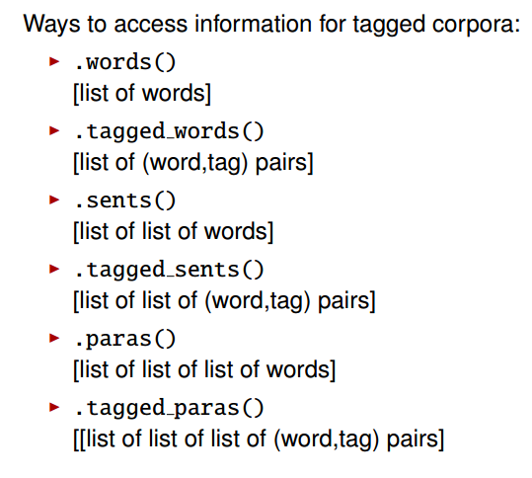

Corpus reading options

Slide 11
Automatic POS tagging
nltk.DefaultTagger():
>>> raw = ’I do not like green eggs and ham, I \ do not like them Sam I am!’
>>> tokens = nltk.word_tokenize(raw)
>>> default_tagger = nltk.DefaultTagger(’NN’)
>>> default_tagger.tag(tokens)
[(’I’, ’NN’), (’do’, ’NN’), (’not’, ’NN’), ...]
For stored data (lists of lists of word/tag pairs), you can use .evaluate()
>>> brown_tagged_sents = brown.tagged_sents(categories=’news’)
>>> default_tagger.evaluate(brown_tagged_sents)
0.13089484257215028

Slide 12
Regular Expression Tagger
Regular expressions capture patterns compactly
patterns = [
... (r’.*ing$’, ’VBG’), # gerunds
... (r’.*ed$’, ’VBD’), # simple past
... (r’.*es$’, ’VBZ’), # 3rd sg. pres.
... (r’.*ould$’, ’MD’), # modals
... (r’.*\’s$’, ’NN$’), # possessive nouns
... (r’.*s$’, ’NNS’), # plural nouns
... (r’ˆ-?[0-9]+(.[0-9]+)?$’, ’CD’), # cardinal #s
... (r’.*’, ’NN’) # nouns (default)
... ]
>>> regexp_tagger = nltk.RegexpTagger(patterns)
Note that the patterns are applied in order

Slide 13
Chunking

Slide 14
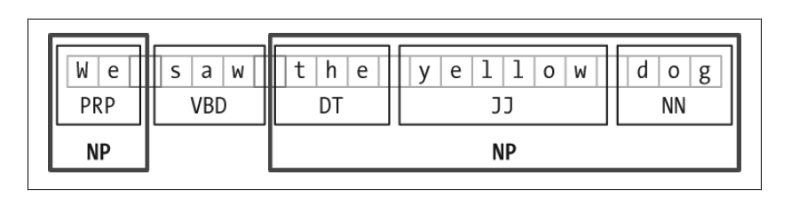
Chunking
Chunking is the basic technique for entity recognition, which selects a subset of the tokens.
The pieces produced by a chunker do not overlap in the source text.

Slide 15
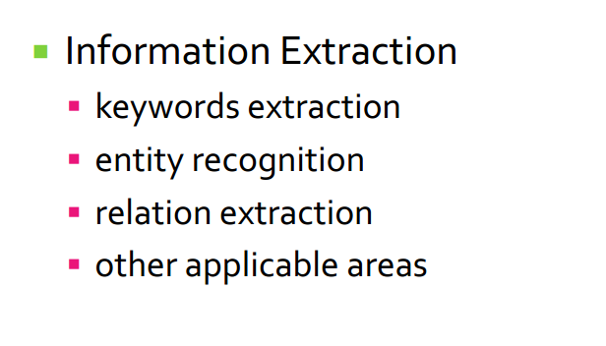

Why Chunking?

Slide 16
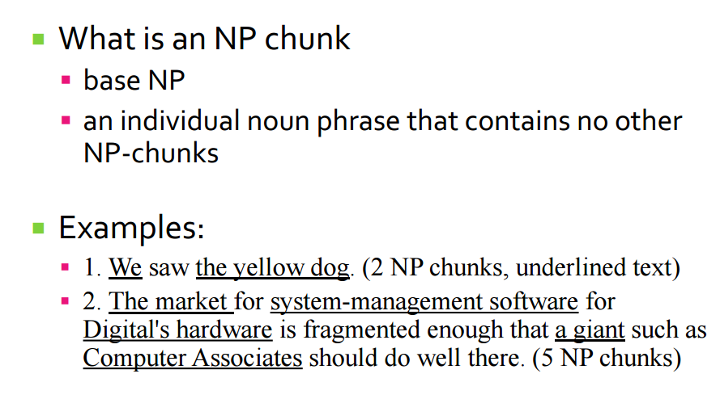
Noun Phrase Chunking

Slide 17
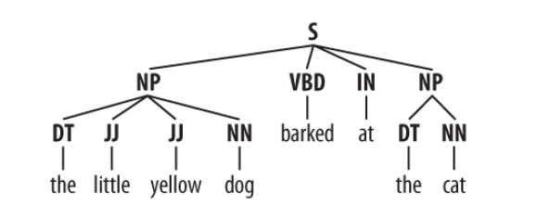
Noun Phrase Chunking
An NP chunk should be formed whenever the chunker finds an optional determiner (DT) followed by any number of adjectives (JJ)
and then a noun (NN).

Slide 18
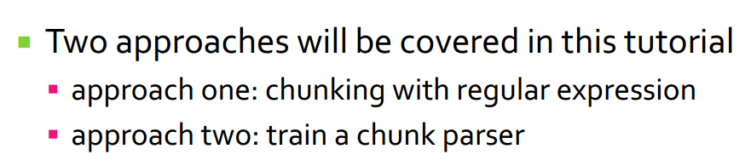
Chunking with NLTK?

Slide 19
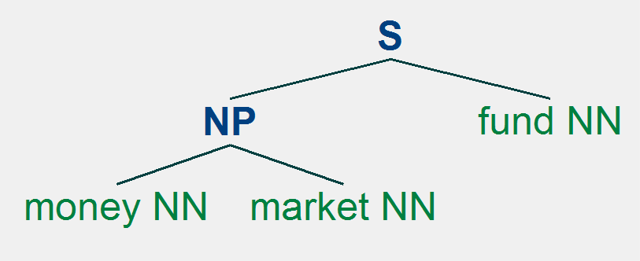
Chunking with Regular Expressions
the RegexpParser chunker begins with a flat structure in which no tokens are chunked. The chunking rules are applied in turn, successively updating the chunk structure.

Slide 20
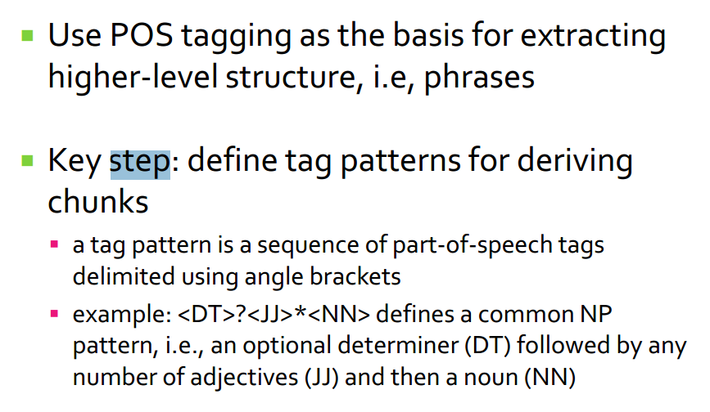
Chunking with Regular Expressions

Slide 21
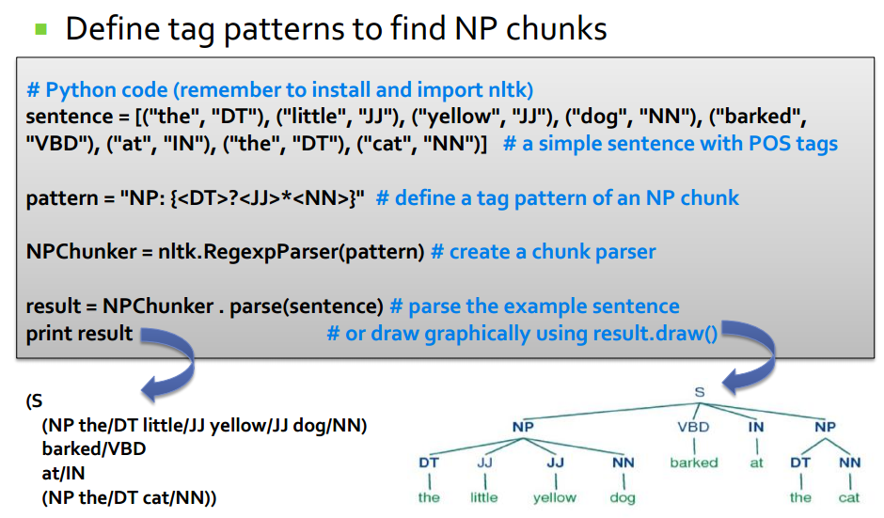
Chunking with Regular Expressions

Slide 22
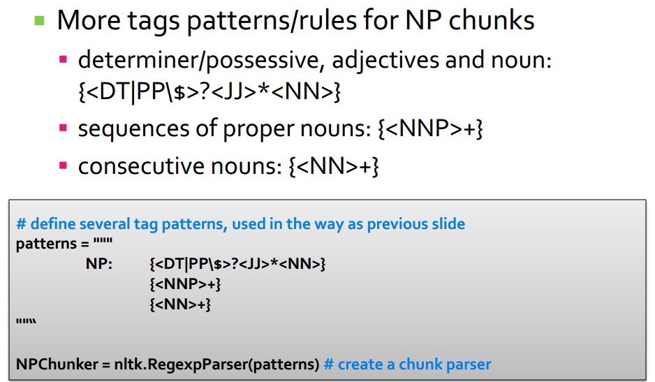
Chunking with Regular Expressions

Slide 23
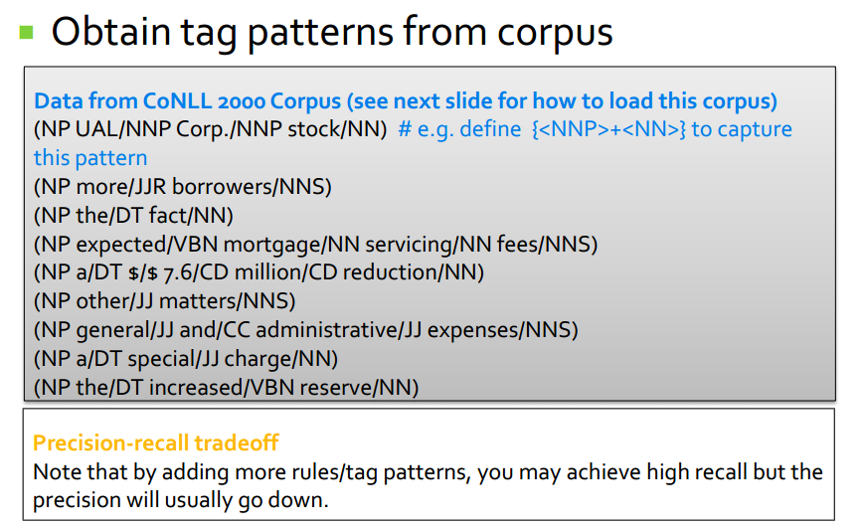
Chunking with Regular Expressions

Slide 24
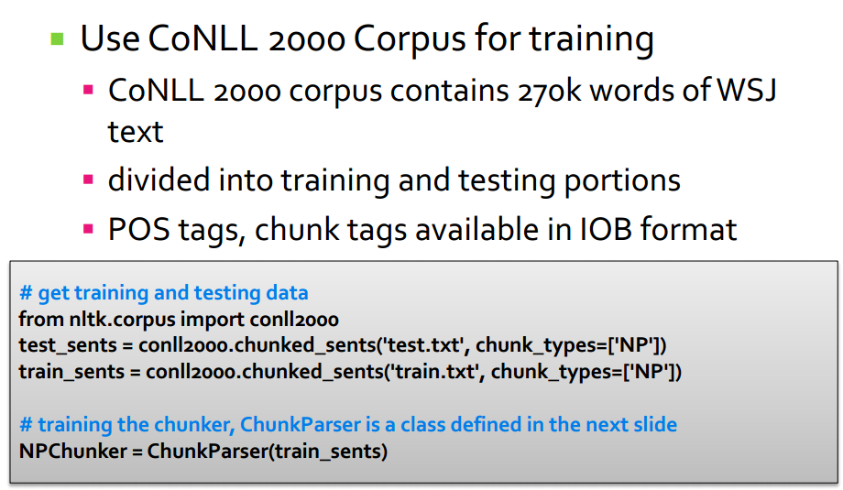
Training a Chunk Parser with NLTK

Slide 25
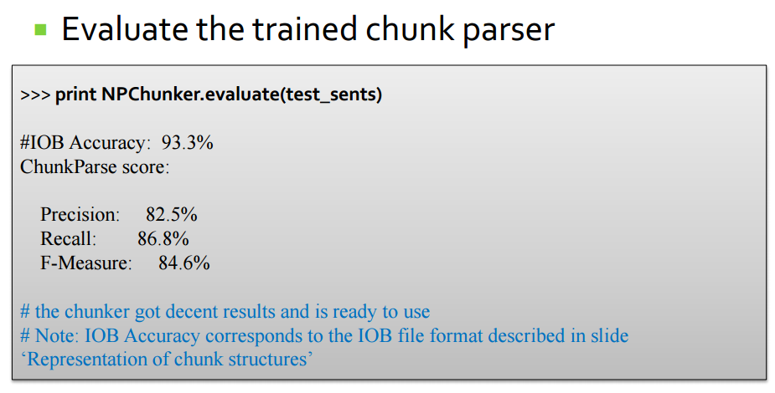

Slide 26
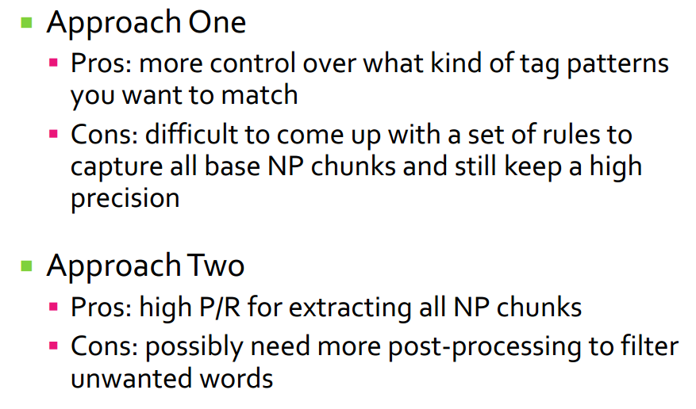
Comparison

Slide 27
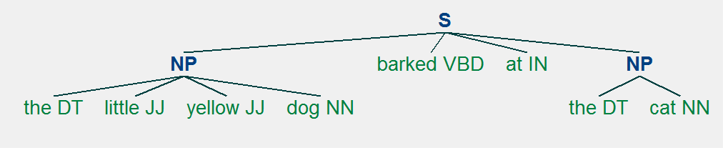
Chinking
We can define a chink to be a sequence of tokens that is not included in a chunk.
barked VBD at IN is a chink

Slide 28
Trees

Slide 29
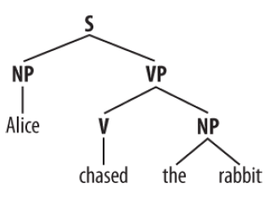
Trees
A tree is a set of connected labeled nodes, each reachable by a unique path from a distinguished root node.

Slide 30
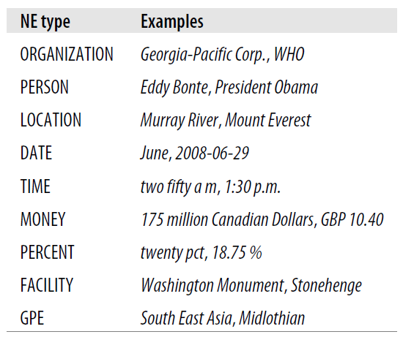
Named Entity Recognition
Named entities are definite noun phrases that refer to specific types of individuals, such as organizations, persons, dates, and so on.

Slide 31


Named Entity Recognition

Slide 32
Thank you!

